Slide 1
Strike 3!
The journey of spiritual transformation

Slide 2
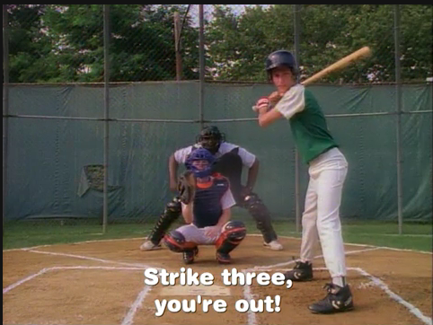

Slide 3
Simon Peter
John 1:41-42
The first thing Andrew did was to find his brother Simon and tell him, “We have found the Messiah” (that is, the Christ). And he brought him to Jesus.
Jesus looked at him and said, “You are Simon son of John. You will be called Cephas” (which, when translated, is Peter).

Slide 4
Three events in Peter’s life
Repent
Restore
Renew

Slide 5
3 Denials: REPENT (Luke 22:54-62)

Slide 6
Jesus answered, “I tell you, Peter, before the rooster crows today, you will deny three times that you know me.”
Luke 22:34 (NIV)

Slide 7
Why did Peter deny?
Fear
“Such love has no fear, because perfect love expels all fear. If we are afraid, it is for fear of punishment, and this shows that we have not fully experienced his perfect love (1 John 4:18, NLT)”
Alone
“A person standing alone can be attacked and defeated, but two can stand back-to-back and conquer. Three are even better, for a triple-braided cord is not easily broken (Ecc 4:12)”
Away from Jesus
“Remain in me, and I will remain in you. For a branch cannot produce fruit if it is severed from the vine, and you cannot be fruitful unless you remain in me (John 15:4)”

Slide 8
3 Denials
Repeated failures must lead to REPENTENCE
Jeremiah 15:19
“Therefore this is what the Lord says:
“If you repent, I will restore you
that you may serve me;
if you utter worthy, not worthless, words,
you will be my spokesman.
Let this people turn to you,
but you must not turn to them.”
If you continue to trust in Jesus, 3 strikes is not an out for you!
REMORSE paves the way for REPENTENCE

Slide 9
3 Affirmations: RESTORE (John 21:15-17)

Slide 10
John 21:15 (NKJV) When they had finished eating, Jesus said to Simon Peter, “Simon son of John, do you love me more than these?” “Yes, Lord,” he said, “you know that I love you.” Jesus said, “Feed my lambs.”

Slide 11
3 Affirmations
Restoration is not a one time process
Despite our failures, Jesus can restore us to serve Him and others.
Our personal story of restoration can be a powerful testimony about God in our lives.

Slide 12
Luke 22:32 (NIV) But I have prayed for you, Simon, that your faith may not fail. And when you have turned back, strengthen your brothers.”

Slide 13
3 Visions: RENEW (Acts 10:9-16)

Slide 14
He saw heaven opened and something like a large sheet being let down to earth by its four corners. It contained all kinds of four-footed animals, as well as reptiles and birds. Then a voice told him, “Get up, Peter. Kill and eat.” “Surely not, Lord!” Peter replied. “I have never eaten anything impure or unclean.” The voice spoke to him a second time, “Do not call anything impure that God has made clean.” This happened three times, and immediately the sheet was taken back to heaven. Acts 10:11-16 (NKJV)

Slide 15
Acts 10:34-35 Then Peter began to speak: “I now realize how true it is that God does not show favoritism but accepts from every nation the one who fears him and does what is right. Acts 10:43 All the prophets testify about him that everyone who believes in him receives forgiveness of sins through his name.”

Slide 16
3 Visions
Our mental models and biasness can hinder our faith.
“Do not conform to the pattern of this world, but be transformed by the renewing of your mind. Then you will be able to test and approve what God’s will is—his good, pleasing and perfect will (Romans 12:2)”
God-given change in mindset releases us fully to do His work.

Slide 17
3 Lessons – a recap
3 denials: REMORSE breaks our human dependence to fully REPENT & depend on God.
3 affirmations: RESTORATION affirms our position in Christ and enables us to serve him and others.
3 visions: RENEWAL of our Minds through a God-given change in mindset releases us fully to do His work.

